Slide 1
Problem Identification
Big Mountain Resort has recently added an extra chair lift to its facilities to spread the visitors more evenly across the mountain, which has increased the resort's operating costs by $1,540,000.
There is a suspicion that the resort is not making the most of its facilities and is looking for guidance to identify the optimal ticket price.
Thus, we set out to investigate what opportunities exist for Big Mountain Resort to better value their ticket price and/or reduce operating costs.

Slide 2
Recommendation and Key Findings
According to our analysis, Big Mountain Resort may be undervaluing its tickets despite having top-notch facilities.
After evaluating various scenarios, we have identified some promising options to improve Big Mountain Resort's competitive position and support higher ticket prices. These include adding new runs and increasing vertical drop, potentially coupled with additional chair lifts.
Our analysis shows that the additional revenue generated may be sufficient to cover the cost of adding the chair lift and even provide a surplus for other investments or operational expenses.
Having more comprehensive cost data such as maintenance costs, labor expenses, and other operational expenses would have been helpful for a thorough analysis.

Slide 3
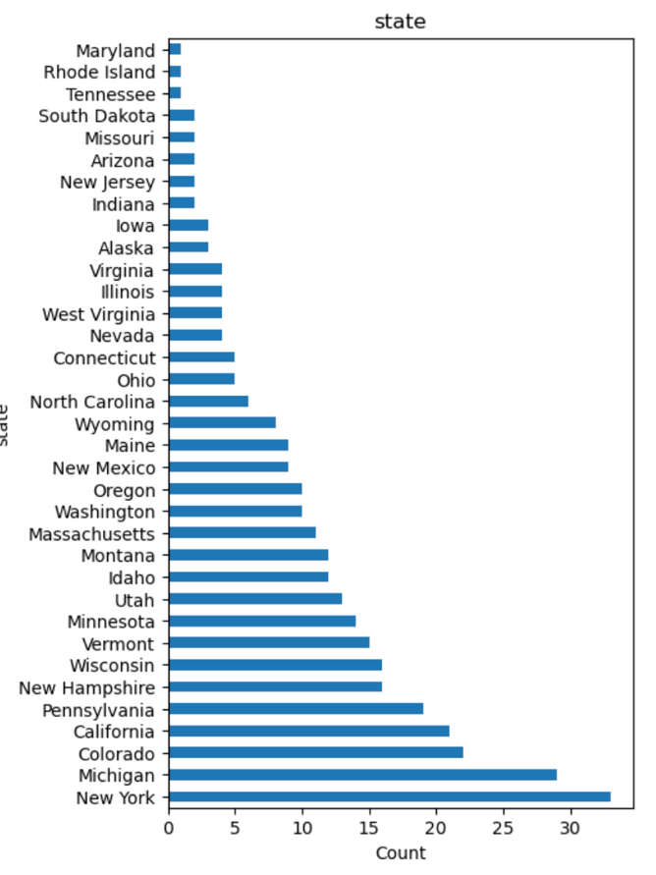
Exploratory Analysis
Initial data cleaning involved addressing missing values and identifying unique resort names.
Notably, Montana did not rank in the top 10 regarding the number of resorts nationwide, highlighting the competitive landscape.
Further analysis examined the relationship between regions and states, facilitating a comprehensive understanding of geographical distribution.
We discovered that most prices appear to lie in a broad band from around 25 to over 100 dollars.

Slide 4
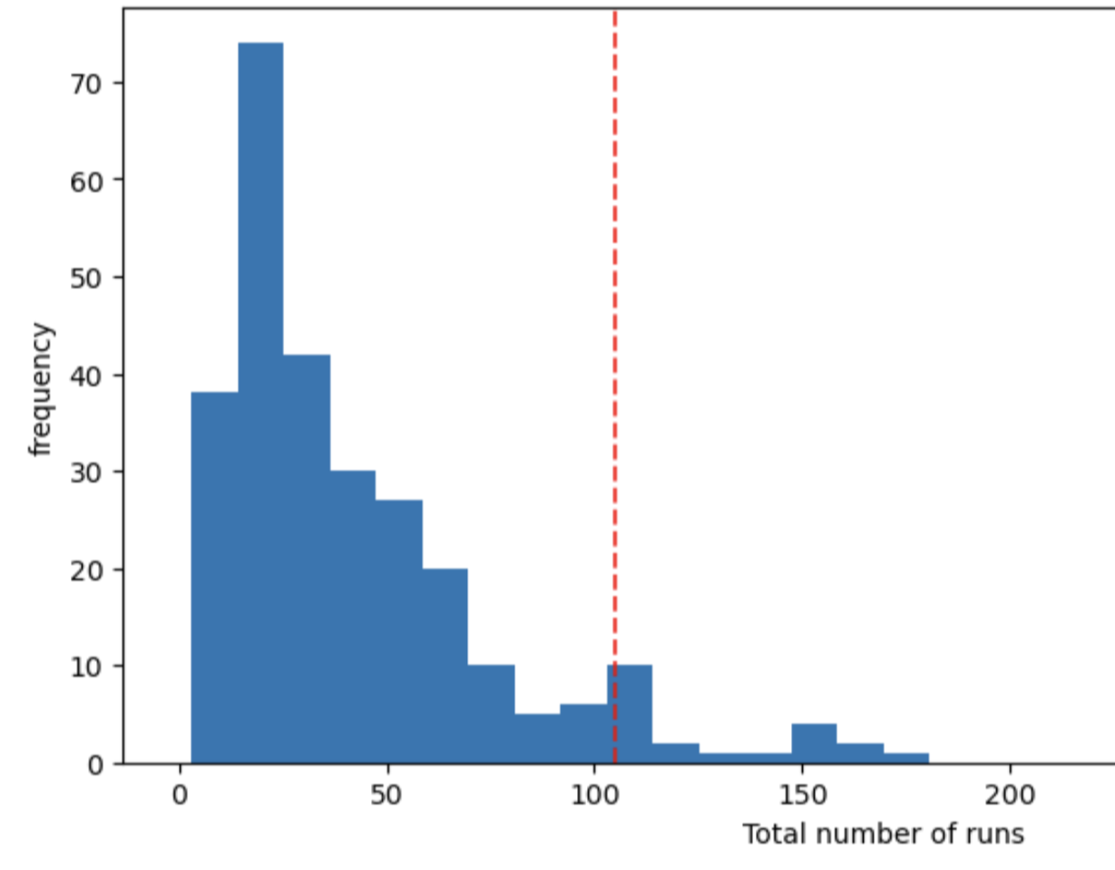

Modeling Results & Analysis
Our analysis suggests that Big Mountain Resort may be undervaluing its tickets compared to other resorts in the market despite having top-notch facilities.
However, we must also consider that Big Mountain's prices are already among the highest in Montana. An excessive price increase could deter visitors who prefer more affordable resorts in the area.
The random forest model emerged as the preferred choice for its superior predictive performance.

Slide 5
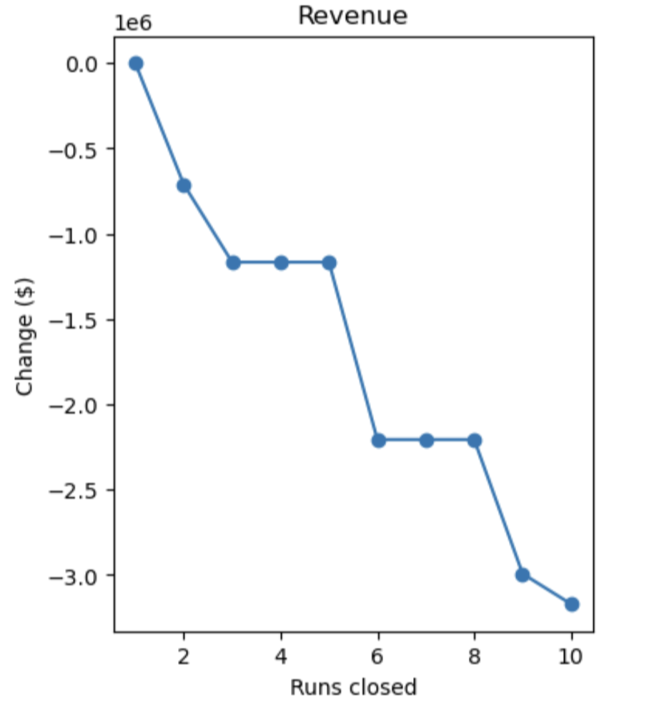
Modeling Results & Analysis
Raising ticket prices by enhancing Big Mountains’ facilities could lead to significant revenue gains, particularly given the expected number of visitors over the season.
Alternatively, cutting costs could also increase revenue. Therefore, we modeled various scenarios to explore potential revenue increases or cost reductions.
According to modeling results, closing runs may not affect ticket prices initially, but it could lead to revenue declines if there are more extensive closures.

Slide 6
Modeling Results & Analysis
After evaluating various scenarios, we have identified some promising options to increase revenue, which include adding new runs and increasing vertical drop, potentially coupled with additional chair lifts.
Our analysis shows that the additional revenue generated ($3,474,638) is sufficient to cover the cost of adding the chair lift and even provides a surplus for other investments or operational expenses.

Slide 7
Summary & Conclusion
An increase in ticket prices, coupled with strategic facility enhancements such as adding new runs and increasing vertical drop, could help offset operating costs associated with recent investments, such as installing an additional chair lift.
It’s also worth considering closing one of the runs since, according to our modeling, it could reduce costs without significantly affecting ticket prices.
Future work could integrate additional data sources, such as visitor demographics and competitor pricing, to further enhance pricing optimization efforts.

